Slide 1

CUSTOMER CHURN PREDICTION USING MACHINE LEARNING
Bindiya Sandeep Kumar
bindiya_sandeepkumar@yahoo.com
GitHub link:
1

Slide 2
Biography
Education
Industry Certification in Data Science & Artificial Intelligence
Post Graduate in Planning & Entrepreneurship Specializing in HR, Marketing & IT
Bachelor degree in Information Technology and Management
Professional Experience
Graduate Data Scientist - Institute of Data - RMIT
Administration Officer – Bastow Institute of Educational & Leadership
Examination Coordinator – Indian Institute of Planning & Management
IT – Recruiter – Bhilwara Info Tech
2

Slide 3
AGENDA
1.Business Problem Definition
Business question vs Data questions
2.DATA Process Design
How work process
3.Values delivery
Modelling accuracy
4.Next steps and Summary
Future improvements
3

Slide 4

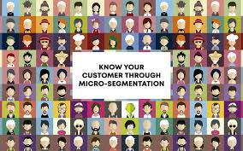
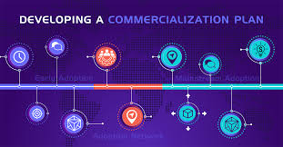


Background
Telecom Sector - Saturation Point
Big data mining - Identifies specific customer needs
Marketing Function – customers needs more accurately identified and serviced
4

Slide 5



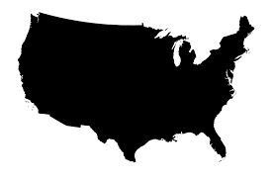





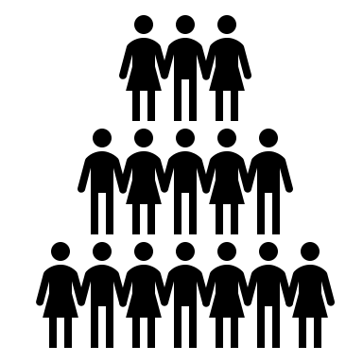
CUSTOMER CHURN CYCLE
Revenue loss
Pressure to acquire new customers
More expensive to add new customers than to retain existing ones
Churned customers may take away the loyal customers
Customer stops using the company’s services
5

Slide 6



Business Question
How earlier can we predict our customers who are more likely to churn?
Busines Goals
Better customer retention management upon initial diagnosis of churning customers.
R
E
V
E
N
U
E
Factors influencing customers to leave our subscription - helps business to figure out better marketing campaign.
L
O
W
C
O
S
T
Identify the old customers and provide loyalty points - improves customer satisfaction and turn them into loyal customers & word of mouth attracts new customers
6

Slide 7

Data Questions
1.Based on the historical customer data trying various machine learning algorithms which model could give us the highest accuracy on predicting the customers who are more likely to quit the subscription?
2.What are the underlying factors which influences the customers to churn?
7

Slide 8

Data Quality - Requirements
Prepaid Customers Info
Post-Paid Customers Info
Early Churn Customers Info
1.Helps to understand customers check points.
2.Better model built with highest accuracy score contributing appropriate business solutions.
Data Set characteristic
Data Gathering
Customer Call Detail
Record
Call Center Contact Detail Customer Personal Information
Input Data Source
Active days
Average call distance
Maximum Inactive days
Network Age
Six months average revenue & usage
Month to month value changes
Derived Features
8

Slide 9
AGENDA
1.Business Problem Definition
Business question vs Data questions
2.DATA Process Design
How work process
3.Values delivery
Modelling accuracy
4.Next steps and Summary
Future improvements
9

Slide 10
Process Workflow
Business Question
Validation
Story Telling
Modelling
Data Question
Data Preproccessing
Data Gathering
Exploratory Data Analysis
10

Slide 11
Dataset Information
4250 Unique Customers Record
Imbalance Dataset
Predictor Variable – Churn (Yes/No)
Features
Float Variable
Integer Variable
Categorical Variable
Total Day Minutes
Total Day Charge
Total Evening Minutes
Total Evening Charge
Total Night Minutes
Total Night Charge
Total International Minutes
Total International Charge
Account Length
Number of voice mail Messages
Total Day Calls
Total Evening Calls
Total Night Calls
Total International Calls
Number of Customer Service Calls
Area Code
State
International Plan
Voicemail Plan
11

Slide 12
AGENDA
1.Business Problem Definition
Business question vs Data questions
2.DATA Process Design
How work process
3.Values delivery
Modelling accuracy
4.Next steps and Summary
Future improvements
12

Slide 13




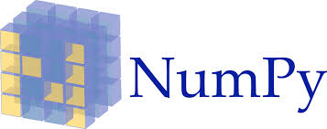




Machine Learning Tools
13

Slide 14
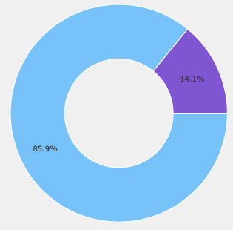
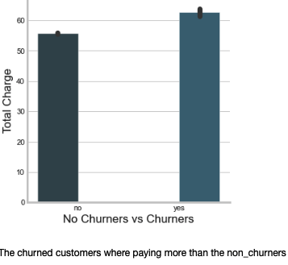
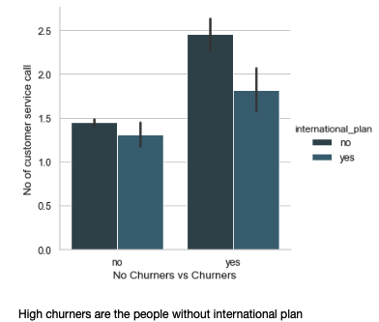
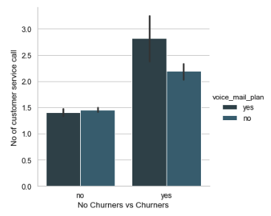
Exploratory Data Analysis
Churned customers where paying more
85% of non churners and 14.1 % of Churners
High churners are the one without International Plan
Customers with voice mail plan are the churners & with high customer service calls
14

Slide 15
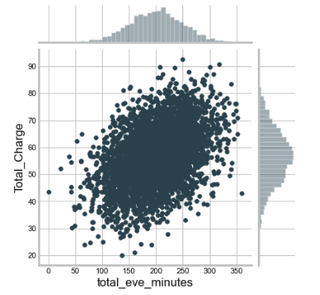
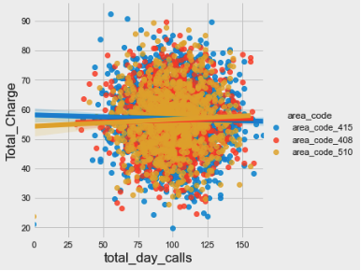
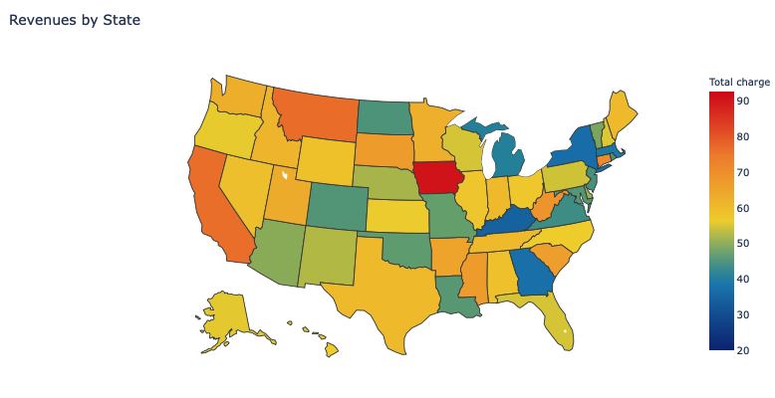
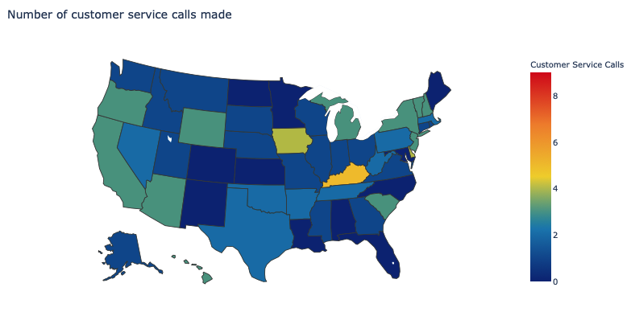
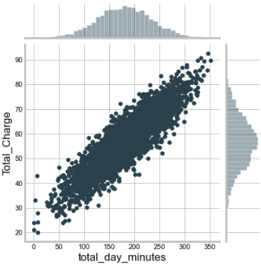
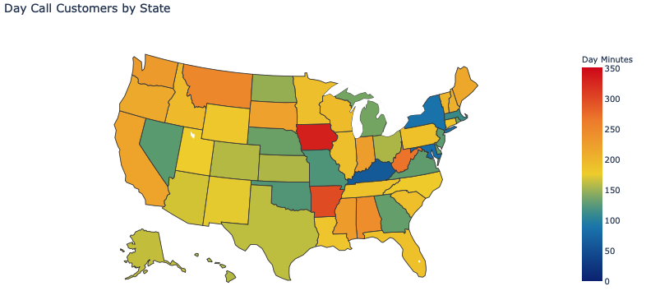
Exploratory Data Analysis
More churners are from the area code 415
Business has to focus evening call customers
IA highest revenue generating states
IA and KY , AZ, CA, WY and OR – Highest customer service calls
Business has to focus –customer retention
Day call customers

Slide 16
Models experimented including all the features with SMOTE & without SMOTE with best optimal parameters.
SMOTE– Synthetic Minority Over-sampling Technique
Synthetic samples are generated for the minority class which balances the class distribution and improves the model performance by not being biased to majority class.
Over sampling the minority class of training data prior to fitting a model.
Overcomes the overfitting problem posed by random oversampling.
Support Vector Machines
Logistic Regression
GaussianNB
Descision tree Classifier
Random Forest Classifier
ADABoost
Keras Classifier
XGBoost Classifier
CatBoost Classifier
15

Slide 17

Model Hyperparameter Optimization
Hyperparameter Optimal Values
n_estimator = 630
learning _rate = 0.02,
booster = 'dart',
min_child_weight = 2,
nthread = -1,
reg_lambda = 0.000537188870140782,
alpha = 4.183769589573285e-07,
scale_pos_weight=1,
max_depth = 8,
colsample_bytree=0.8,
eta = 0.1041103115293149,
gamma = 0.009723248119317662,
grow_policy = lossguide
Possible to specify how long the optimization process should last.
Easier to use than Hyperopt
Pruning discard low-quality trials early
16

Slide 18
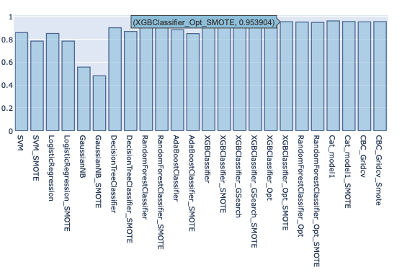
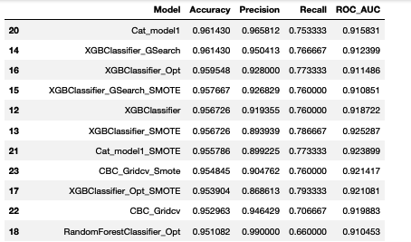
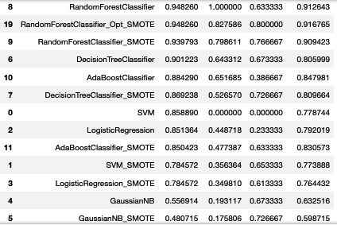
XGBoost Model with Smote oversampling technique using optuna hypermeter tuning gave the highest accuracy in classifying churners with the least amount of False Negatives.
17

Slide 19
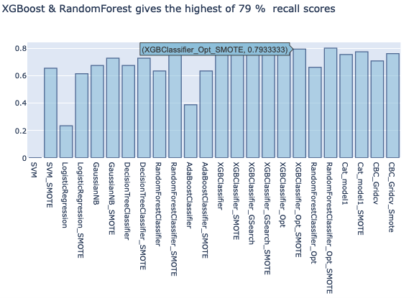
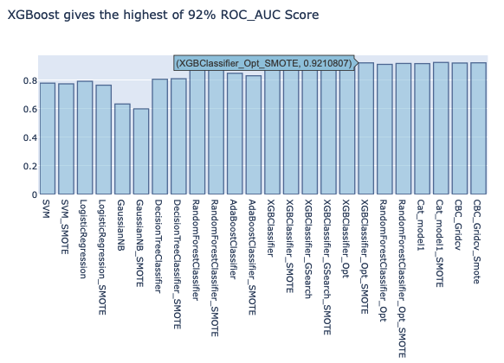
XGBoost & Random Forrest gives the highest of 79% recall scores
XGBoost,RandomForrest, CatBoost & Keras gives the highest of 92% ROC-AUC Scores
18

Slide 20
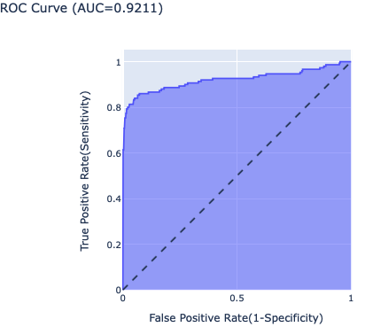
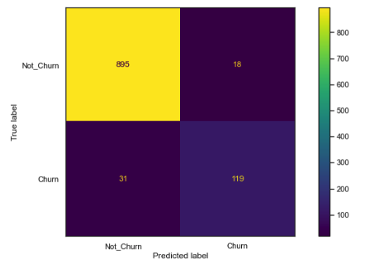
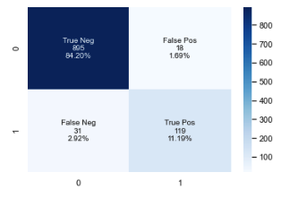
MODEL EVALUATION
Confusion Matrix
ROC CURVE(AUC = 0.9211)
True Positives = 119
False Positives =18
True Negatives = 895
False Negatives =31
Model predicted correctly - 119 customers are most likely to cancel the service & 895 will not cancel the service.
Model predicted wrongly - 18 customers are most likely to cancel the service and 31 customers will not cancel the service.
19

Slide 21
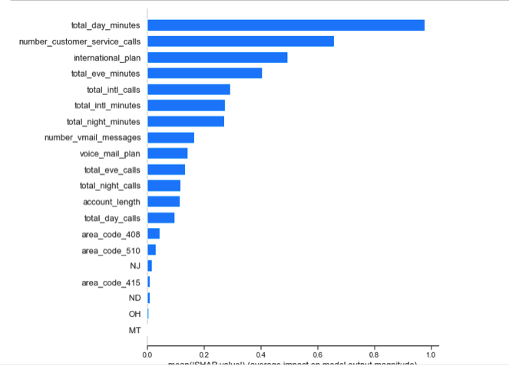
Top 13 factors influencing customers to churn
Shapley Additive explanation
Created by computer scientist to enable the accuracy and the interpretability from machine learning models.
SHAP assigns each feature variable a value
Higher values indicate higher importance in predicting the target variable.
Shap Values
20

Slide 22
AGENDA
1.Business Problem Definition
Business question vs Data questions
2.DATA Process Design
How work process
3.Values delivery
Modelling accuracy
4.Next steps and Summary
Future improvements
21

Slide 23
















Similar models can be applied in various domains:
Insurance Companies
Alarm Security Monitoring Companies
Bank
Pay TV
22

Slide 24
Summary
XGBoost model gave the best accuracy accuracy rate, predicting the customers who are most likely to churn. Business can now focus on customer retention campaigns toward targeted high-risk customers.
Through XGBoost SHAP values we determine the model performance and the feature importance which was influencing the customers to quit the subscription.
Future Work: Adding more features like customer complain type, resolution time, demographic information of the subscriber & sentiment analysis on customer feedback for better insights.
23

Slide 25
Reference
Dataset is from Kaggle Competition 2020:https://www.kaggle.com/c/customer-churn-prediction-2020
https://www.strategyand.pwc.com/m1/en/reports/hitting-the-target.pdf
https://www.analyticsvidhya.com/blog/2016/03/complete-guide-parameter-tuning-xgboost-with-codes-python/
https://towardsdatascience.com/explain-your-model-with-the-shap-values-bc36aac4de3d
https://machinelearningmastery.com/smote-oversampling-for-imbalanced-classification/
24

Slide 26
Thanks
Does anyone has any questions?
25

